Slide 1

Benefits of Strategic Alliances for Innovation
How Organizations Use Partnerships to Drive Innovation and Growth
ASHLEYS

Slide 2

Introduction
🔹 In today's highly competitive business environment, companies need to innovate continuously to stay ahead. However, innovation often requires significant resources, expertise, and time. 🔹 Strategic alliances allow organizations to collaborate with other companies to share knowledge, technology, and resources, making innovation more efficient and cost-effective. 🔹 By forming partnerships, companies can develop new products, enter new markets, and reduce the risks associated with innovation.

Slide 3
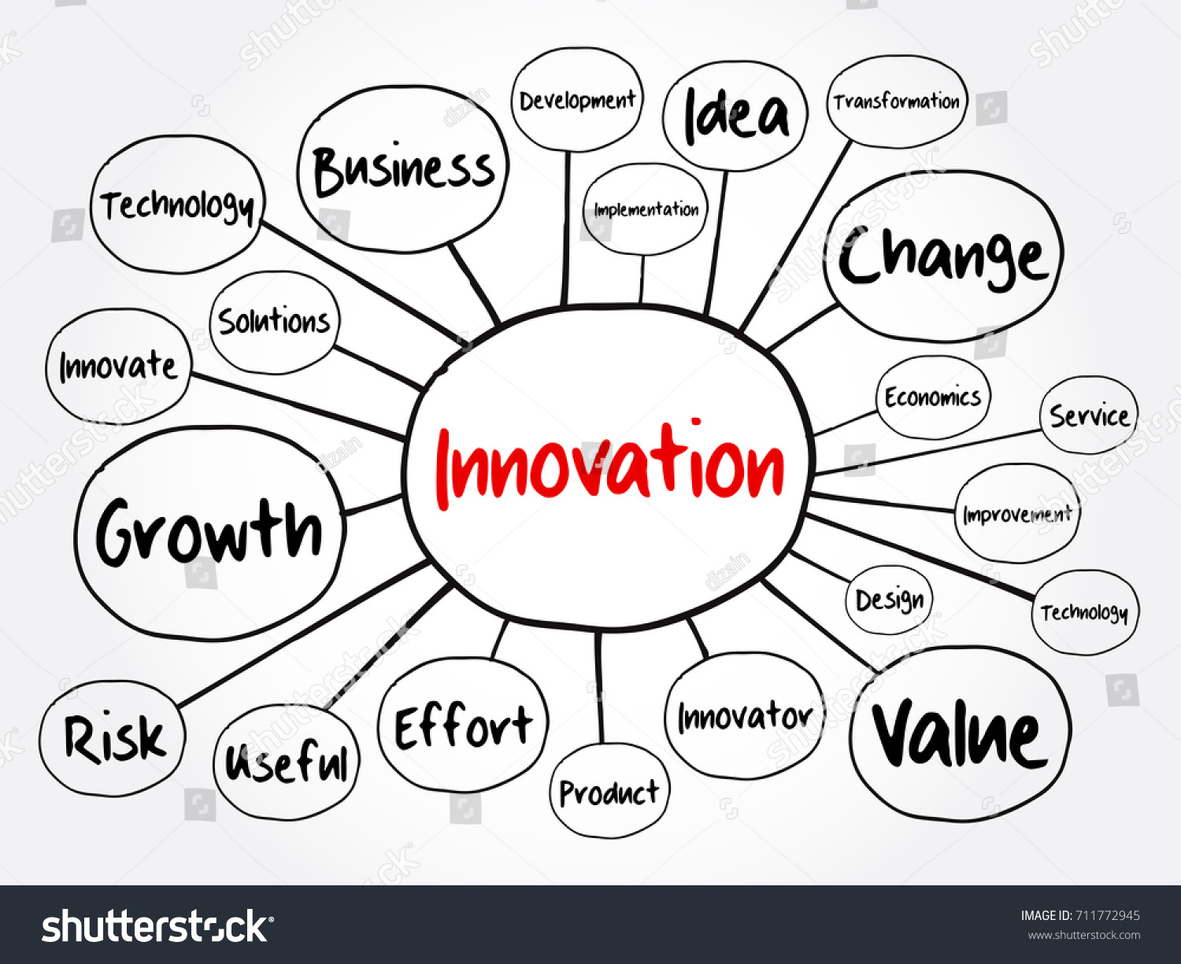
New Ideas and Expertise Access
💡 Cross-Pollination of Knowledge
When companies partner, they gain access to each other's expertise, knowledge, and skills.
These alliances create a space for brainstorming and collaboration, leading to new ideas and unique innovations.
Employees from different organizations bring fresh perspectives that help solve complex problems.
🔬 Specialized Knowledge
Many industries require specialized technical or domain knowledge to develop innovative solutions.
One company may have cutting-edge technology, while the other has deep market insights, creating a perfect combination for innovation.
Partnerships between technology firms and market leaders can result in disruptive innovations that shape the industry.

Slide 4


Shorter Time to Market
🚀 Shared Resources and Capabilities
Strategic alliances enable companies to combine their research and development (R&D) efforts, technology, and financial resources to accelerate product innovation.
Working together allows faster prototyping, testing, and product launches, reducing the time required to bring innovations to market.
⚠ Risk Mitigation
Developing new products or services involves financial and operational risks.
By sharing resources, the financial burden is divided, allowing companies to undertake ambitious innovation projects that may have been too risky alone.
This collaboration ensures that even smaller firms can participate in large-scale innovations.

Slide 5


Cost Savings
💰 Shared Costs
Innovation, especially in areas like research, development, and technology acquisition, requires significant investment.
Strategic alliances distribute these costs among multiple organizations, making it more affordable for each partner.
📉 Economies of Scale
Collaborating organizations benefit from economies of scale by reducing per-unit costs of development and production.
By leveraging each other's manufacturing, logistics, or distribution networks, companies can optimize costs and increase efficiency.

Slide 6
Access to New Markets
🌍 Greater Reach
Many companies struggle to expand into new geographic regions or customer segments.
Strategic alliances allow organizations to leverage their partners' existing customer base and market presence.
This partnership enables companies to introduce innovative solutions tailored to new market needs.
🏛 Local Knowledge and Relationships
Entering a new market requires understanding local regulations, consumer behaviors, and business practices.
A local partner provides valuable insights and helps navigate challenges such as cultural differences and regulatory barriers.
This collaboration ensures that innovations are successfully adopted in diverse regions.

Slide 7

Increased Flexibility
🔄 Testing Without Full Commitment
Strategic alliances enable companies to experiment with new technologies, business models, and markets without the high risks associated with acquisitions or mergers.
This flexibility allows businesses to explore innovative ideas while maintaining financial stability.
⚖ Balanced Innovation Effort
Rather than taking on the full burden of innovation, companies can divide responsibilities among partners.
This division of work helps organizations remain focused on their core competencies while still exploring new opportunities.

Slide 8


Risk Sharing & Management
🛡 Less Risk in Innovation
Every innovation carries some level of uncertainty, whether it's market acceptance, technical challenges, or regulatory hurdles.
Strategic partnerships allow companies to share these risks, making them more willing to invest in bold, transformative innovations.
🔀 Diverse Risk Strategies
Different organizations have unique approaches to risk management.
By working together, they can develop a more robust risk-handling strategy that balances financial, operational, and technological risks.

Slide 9

Shared Access to Proprietary Technology
🖥 Technology Sharing
Many firms possess valuable technologies that can enhance innovation when combined with a partner’s capabilities.
Through strategic alliances, companies gain access to proprietary tools, software, and systems that would otherwise be costly or unavailable.
🤝 Co-Development of Technologies
Rather than just sharing existing technologies, partners can jointly invest in the research and development of new solutions.
This co-creation leads to innovative products and services that neither company could have developed alone.

Slide 10

Enhanced Competitive Positioning
📈 Market Strength
A strong strategic alliance can help companies strengthen their market position by pooling their strengths and capabilities.
By combining resources, companies can compete more effectively against industry giants.
🏆 Industry Leadership
Businesses that form successful alliances often become industry leaders, driving innovation and setting market trends.
Such collaborations can lead to game-changing innovations that disrupt industries and redefine competition.

Slide 11

Collaborative Problem-Solving
🔍 Diverse Solutions
Bringing together teams from different companies fosters diverse thinking and more creative problem-solving.
Partners contribute unique perspectives that lead to breakthrough innovations and smarter solutions.
🚧 Overcoming Barriers
Many businesses face regulatory, technical, or operational challenges that slow down innovation.
A strategic partnership can help navigate these obstacles more effectively, allowing for faster implementation of new ideas.

Slide 12

Innovation Ecosystem Development
🔗 Network Creation
A strong network of partnerships creates an ecosystem that fosters continuous innovation.
By working with suppliers, customers, and even competitors, companies build dynamic environments where new ideas thrive.
🌍 Cross-Industry Innovations
Some of the most groundbreaking innovations occur when companies from different industries collaborate.
For example, a tech firm working with a healthcare company can lead to revolutionary medical advancements, such as wearable health monitoring devices.

Slide 13

Conclusion
Strategic alliances provide access to expertise, new technologies, and market expansion opportunities.
These partnerships reduce costs, shorten time to market, and improve risk management.
Companies that collaborate effectively can strengthen their competitive position and drive industry-leading innovation.
💭 "How can your organization leverage strategic alliances for innovation?"

Slide 14

CITATIONS
Innovation Management and New Product Development by Paul Trout 7TH edition
Access to New Ideas and Expertise: Chapter 5, "Sources of Innovation," explores how organizations can tap into external knowledge and collaborate with partners to foster innovation. ​renessans-edu.uz
Reducing Time to Market: Chapter 11, "Managing the New Product Development Process," discusses strategies for accelerating product development cycles to bring innovations to market more swiftly. ​
Cost Savings through Collaboration: Chapter 8, "Networks and Innovation," examines how forming strategic alliances and networks can lead to shared resources and cost efficiencies in the innovation process. ​
Accessing New Markets: Chapter 13, "Innovation Strategies," includes insights on leveraging partnerships to enter and establish a presence in new markets. ​
Risk Sharing and Management: Chapter 9, "Risk and Uncertainty in Innovation," addresses how collaborative ventures can distribute and mitigate risks associated with new product development.
Thank you
For you attention

